Slide 1
PeayPark
Jnaria Wheeler, Mitchell Sollmann, Connor Dial

Slide 2

Table of Contents
Introduction
Technology
Design
Diagrams
Supabase Tables
JavaScript breakdown
Deployment and Building
Issues
Conclusion

Slide 3
Introduction
Purpose – Simplify APSU Parking for students , staff and guest
Features – Real-time updates , vehicle reporting....

Slide 4
Introduction Part 2
Benefits
Reduce Traffic and Stress
Encourage Proper Parking
Core features.
Real-time Updates
User Authentication
Admin Monitoring and Edits

Slide 5
Technology used
Front-end (React Native) - Moblie focused and comminity supported
Backend and Authentaction (SupaBase) - User friendly , open-source
Expo (Cross- platform Deployment) - Easy to use, good for testing

Slide 6
Designs Diagrams used
Class Diagram
Entity Relationship Diagram (ERD)
Block Diagram

Slide 7
Supabase Tables
Parking lot Table
Supabase Account Table
Authencatio table

Slide 8
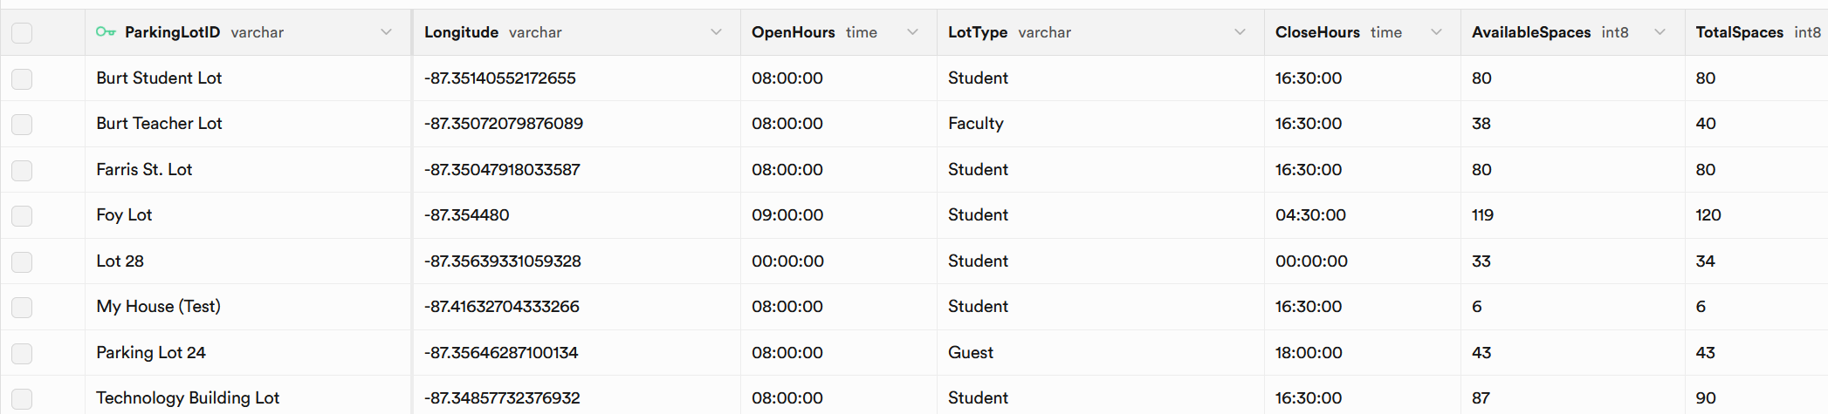
Parking Lot Table

Slide 9
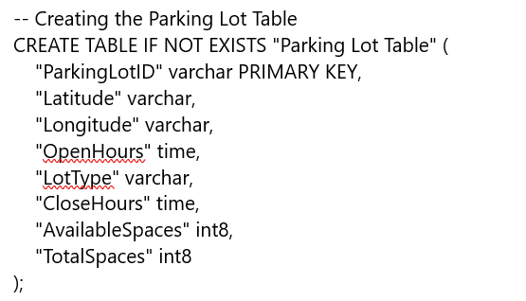
Parking Lot SQL

Slide 10
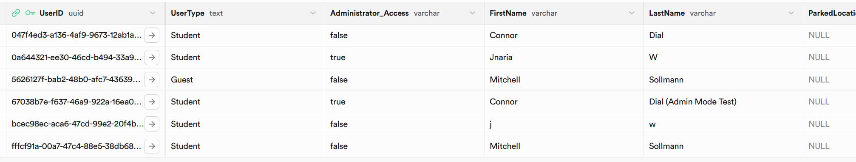
SupaBase Account Table

Slide 11
SupaBase Account table SQL
CREATE TABLE IF NOT EXISTS "SupaBase Account Table" (
"UserID" uuid PRIMARY KEY,
"UserType" text,
"Administrator_Access" varchar,
"FirstName" varchar,
"LastName" varchar,
"ParkedLocation" text,
FOREIGN KEY ("UserID") REFERENCES auth.users(id) ON DELETE CASCADE

Slide 12
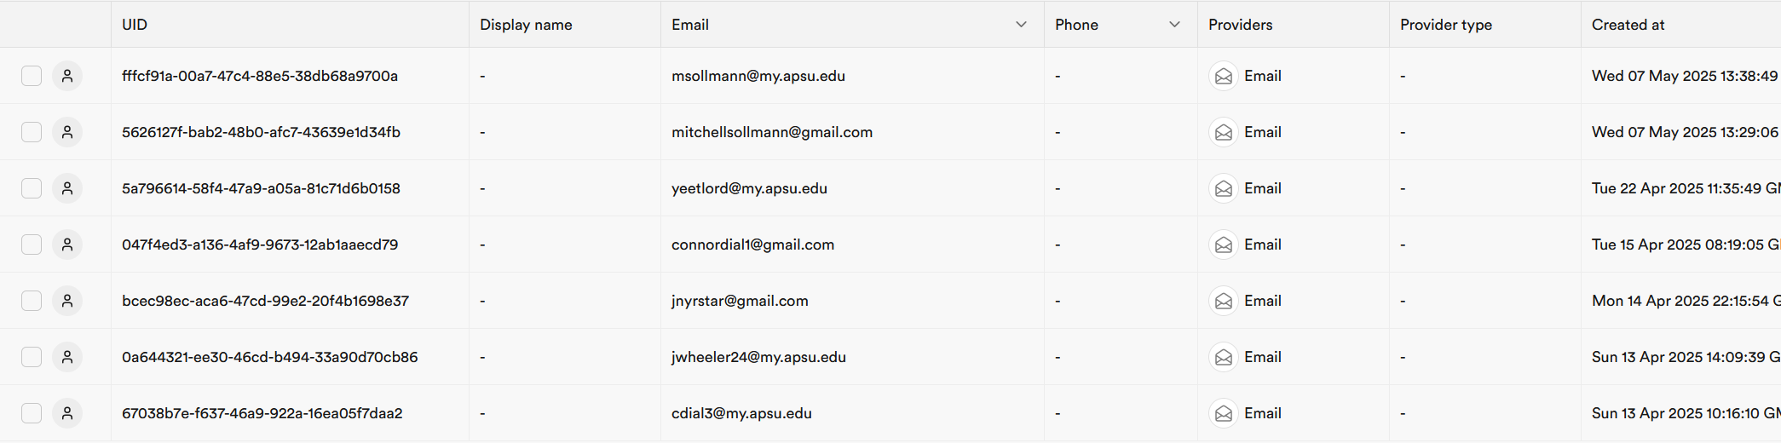
Auth.Users Table

Slide 13
Core App Files
Index.js -Entry point of the React Native app; uses Expo’s registerRootComponent to load the main App component for both Expo Go and native builds.
App.js -connects pages like Login, Admin, and Map, and handles session

Slide 14
User-Facing Pages
LoginPage - User Login and validation
CreateAccountPage – New account setup
ForgotPasswordPage – Sends reset code
VerificationPage - confirms reset
ChangePasswordPage – updates password

Slide 15
Admin& Reports Pages
AdminPage Admin interface & control
ReportinPage Email based user reporting
SettingsPage logout , and admin access

Slide 16
Map & Utility Files
MapPage – Real- time parking view
ParkingFunctions – Shows available spaces
Supabase – Database configure & credentials

Slide 17
How it all worked
Opened Webstorm
Run npm install
Setup SupaBase Tables
Configure supabase.js
Install Expo Go on moblie device
Run npx exp start in terminal on webstorm
Scan QR code that was generated to launch on expo go

Slide 18
Issues
Scalability Consideration
Free Supabase is fine for prototyping, but scaling may cause issues with growing parking data.
One main issue we had was Expo Go getting updated

Slide 19
Conclusion
PeayPark application is a comprehensive parking management solution grounded in modern web technologies
Detailed diagrams, tech specs, and deployment steps, the documentation helps new developers quickly understand and contribute to the project.

Slide 20

Questions?

